Slide 1
Introduction to Elementary Stream(ES) & Packetized Elementary Stream(PES)

Slide 2
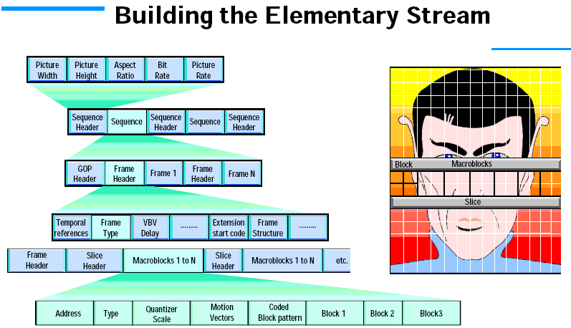
Elementary Stream (ES)

Slide 3
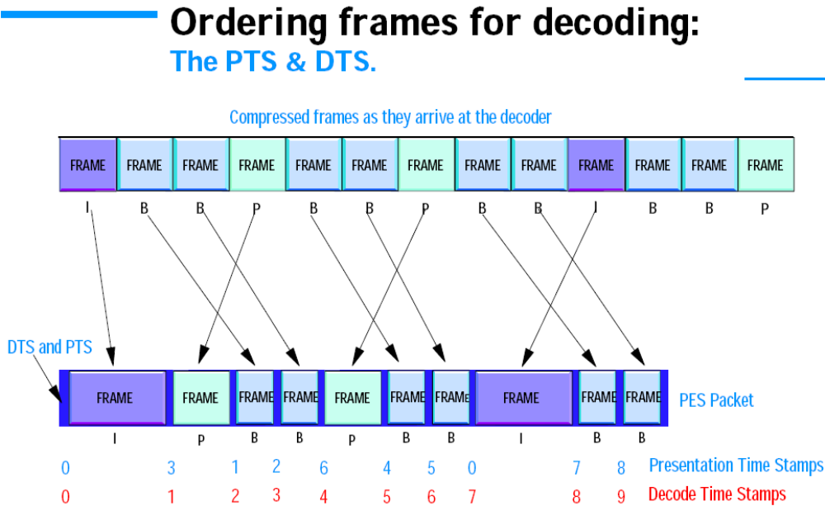
PTS and DTS

Slide 4
PTS and DTS
In order for a decoder to reconstruct a B-frame from the preceding I and following P frames, both these must arrive first.
So the order of frame transmission must be different to the order they appear on the TV screen
But for this to work, the decoder must also know at what time it should show the frames. That its their order in time.
DTS tells the decoder when to decode the frame
PTS tells the decoder when to display the frame
In addition to knowing at what time decode and presentation should occur, a clock must be embedded, to allow a time reference to be created
The PTS and DTS are added to the Packetized Elementary Stream, while the clock, known as the Program Clock Reference (PCR) is contained in the Transport stream

Slide 5
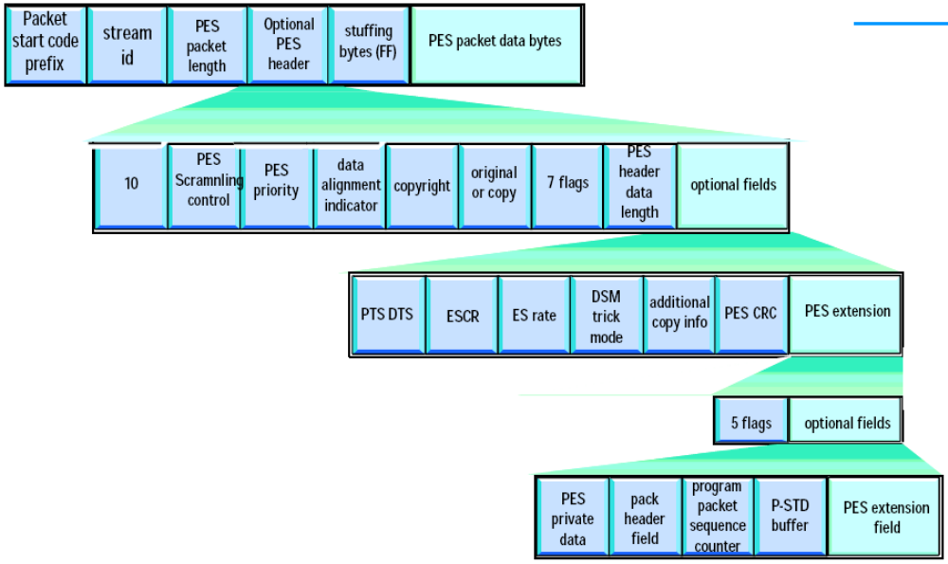
Packetized Elementary Stream (PES)

Slide 6
Packetized Elementary Stream (PES)
Each PES packet containing a header and a payload.
Payload contains only Audio or Video or Data Access Units- No Programme guide information
The PES packets can be of variable length, typically up to 64 Kbytes, but they can be longer.
The PES header includes timing information, PTS and DTS, these allow the decoder to reconstruct the video stream from the I, B, P frames sent by the encoder.
The important thing to note is that if information carried in the header is corrupted, the entire PES packet will be lost.
The next stage is to multiplex many PES together to create a stream of many TV programme events

Slide 7
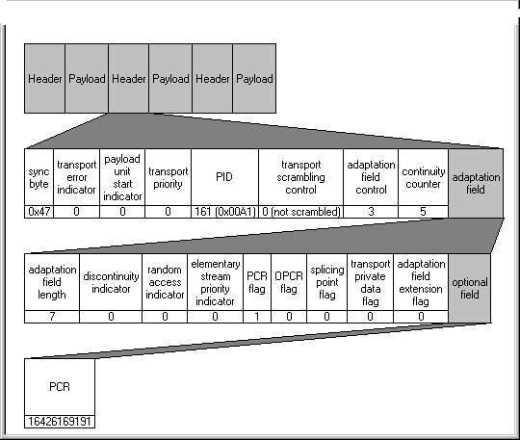
The Packet Header
Notes:
MPEG/DVB Overview
Tektronix
As mentioned previously ETR 290 focuses mainly on testing the transport stream layer. The first test is to ensure that the transmission contains a valid transport stream. An MPEG-2 transport stream is made up of 188 byte packets each of which starts with a four byte header as shown in the slide. The first byte of the header is the sync byte and is always 0x47. In order to synchronise to the transport stream the test equipment must detect 5 consecutive sync bytes spaced 188 bytes apart. Once synchronisation is obtained other elements of the header can be tested such as the continuity counter and transport error indicator.
In order for a settop box to successfully decode a transport stream it must lock its own local 27 MHz clock with that at the encoder. This is achieved using the Program Clock Reference (PCR) which is a 42 bit sample of the encoder clock. The PCR is inserted into the adaptation field and must be repeated in the transport stream every 40 mS. The PCR must be accurate to +/- 500 ns.

Slide 8
MPEG-2 Transport stream
The TS takes the variable length PES, and chops it up into fixed length of 188 byte packets: this is required for most transmission systems.
Like the PES packet, each transport packet also contains a header and a payload.
One packet contains one type of data only i.e. video, audio, data, programme guide information.
Many PES multiplexed or merged, with similarly packetized content for other services.
A multiplex composed of one or more services is called a transport stream.
The key features are as follows:
    Sync Byte, sets the start of a TS packet and allows transmission synchronization.
    Transport Error indicator indicates the packet is in error.
    PID (Packet Identifier) enables the decoder to sort through the packets in a transport stream to reconstruct programmes. PID values are contained in the PSI tables.
    PCR (Programme Clock Reference) provides 27 MHz clock recovery information.

Slide 9
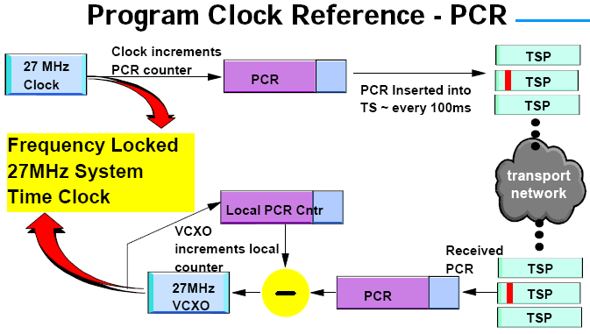
Timing: PCR

Slide 10
Program Clock Reference (PCR)
To ensure proper synchronization during the decoding process, the decoder’s clock must be locked to the encoder’s STC (System Time Clock)
PCR is a clock recovery mechanism for MPEG programs. When a program is encoded, a 27MHz STC drives the encoding process.
When the program is decoded, the decoding process must be driven by a clock which is locked to the encoder's STC. The decoder uses the PCR to regenerate a local 27MHz clock.
When a program is inserted into the Transport Stream a 27MHz timestamp is inserted - the PCR. At the decoder end, it uses a Voltage Controlled Oscillator (VCXO) to generate a 27MHz clock. When a PCR is received, it is compared to a local counter which is driven by the VCXO, and the difference is used to correct the frequency of the VCXO to ensure that the 27MHz clock is locked to the PCR.
The PCR field is a 42 bit field in the adaptation field of the Transport Stream.

Slide 11
Thank you

Slide 12


